Slide 1

CISW 400 (Online) – Client-side Scripting for the Internet
PRESENTATION 1c:
External & Inline
JavaScript
Cosumnes River College
Fishman – 2020
CISW 400 - CRC - Fishman 2019 / 2020

Slide 2

CISW 400 – Client-side Scripting for the Internet
In previous examples, we have seen Internal JavaScript, that is code inserted directly inside of the html for a particular web page.
Sometimes, it is more efficient to write External JavaScript code. That is code that resides in a separate file to be referenced from one or more web pages.
This presentation examines External JavaScript, and also discusses Inline scripting.

Slide 3
External & Inline Scripts
A. External Scripts
B. Inline JavaScript
CISW 400 - CRC - Fishman 2019 / 2020

Slide 4
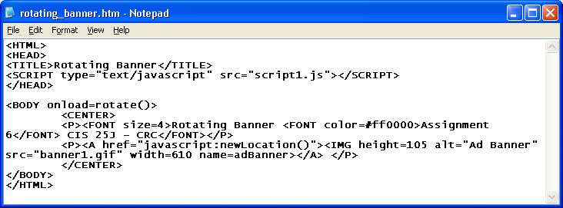

External Scripts
It is possible to write your JavaScript code in a separate text file, saved with a .js file extension. You can then link a web page to your external script file, by including a "link" tag in the head section. This is sometimes referred to as a JavaScript "include".
The advantages of using external scripts include the following:
1. Separation
3. Script file is Cached
It is easier to isolate problems.
Meaning it doesn't need to be downloaded again for each page that uses it
2. Apply script file to multiple pages.
Easier to update, make global changes.
CISW 400 - CRC - Fishman 2019 / 2020

Slide 5
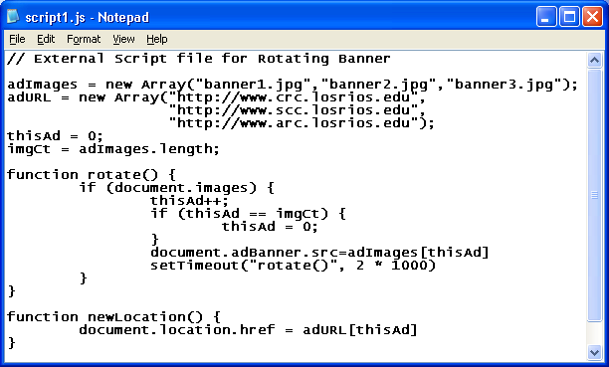
External Scripts
Example:
We link to the script, in the page's <head>. Then all of the methods and variables that are in that file are available to use in the page.
Don't forget the closing </SCRIPT> tag.
To import scripts from external JS files, save the code in a text file with the .js extension; without the script tags and comments.
CISW 400 - CRC - Fishman 2019 / 2020

Slide 6
External Scripts
Notes:
Note that JavaScript Includes, like this, are not supported by some older browser versions. Also remember that end-tag.
Always place "includes" in the head so that the browser is ready to execute scripts when the user calls for them. If a user clicked a button that called for a script that the browser wasn't aware of yet, you'd get an error. Having them in the head means they're always ready before they're needed.
CISW 400 - CRC - Fishman 2019 / 2020

Slide 7
External & Inline Scripts
A. External Scripts
B. Inline JavaScript
CISW 400 - CRC - Fishman 2019 / 2020

Slide 8
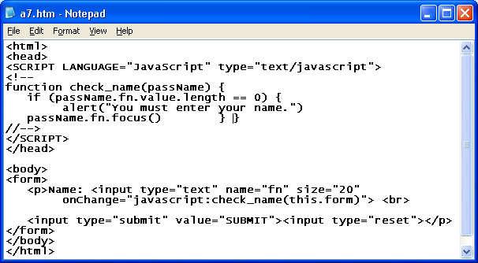
Inline JavaScript
Sometimes, JavaScript is used directly within HTML tags. These "one-liners" are called "inline scripts". We have already used inline script calls, in for example, the Forms Assignment:
Inline JavaScript calls are placed directly within HTML tags.
CISW 400 - CRC - Fishman 2019 / 2020

Slide 9
Inline JavaScript
Example:
Inline JavaScript
CISW 400 - CRC - Fishman 2019 / 2020

